Slide 1
Instance-aware Contrastive Learning for Occluded Human Mesh Reconstruction
Mi-Gyeong Gwon, Gi-Mun Um, Won-Sik Cheong, Wonjum Kim Konkuk University, Electronics and Telecommunications Research Institute
Jiwon Kim

Slide 2
Outline
Introduction
Method
Result
Conclusion

Slide 3
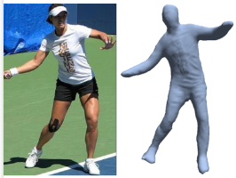
Introduction
3D Human Mesh Reconstruction

Slide 4
Introduction
3D Human Mesh Reconstruction
Model-based Method
Model-free Method

Slide 5
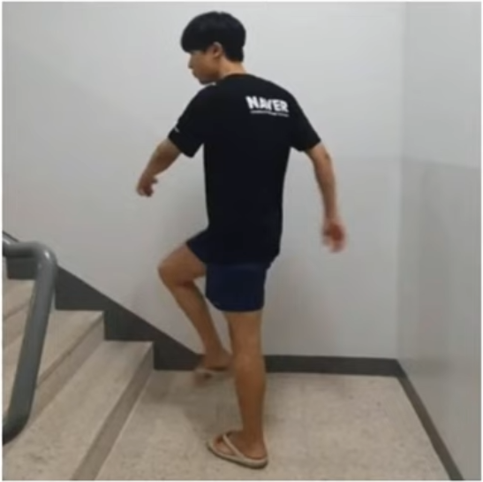
Introduction
3D Human Mesh Reconstruction
Model-based Method
Model-free Method

Slide 6
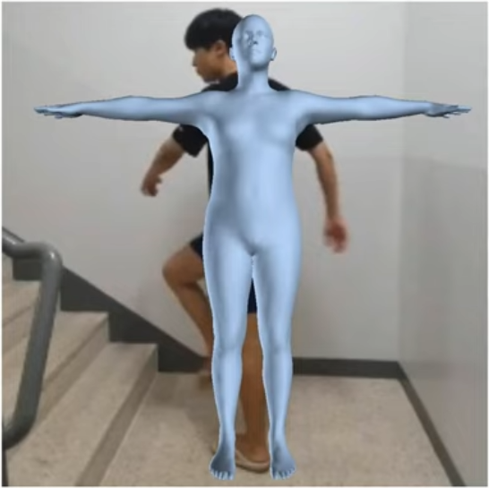
Introduction
3D Human Mesh Reconstruction
Model-based Method
Model-free Method

Slide 7
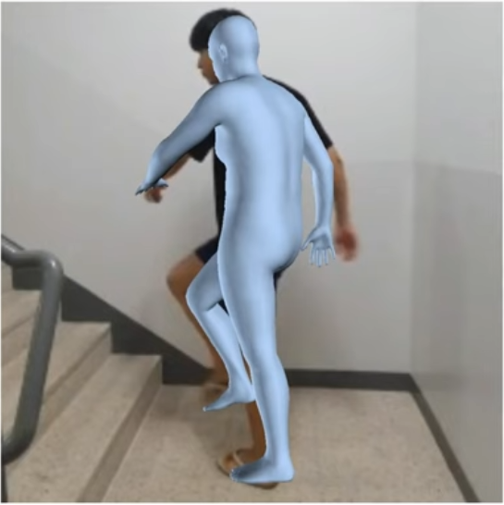
Difficulty in generalizing
Introduction
3D Human Mesh Reconstruction
Model-based Method
Model-free Method

Slide 8
Difficulty in generalizing
Introduction
3D Human Mesh Reconstruction
Limitations of detailed expression
Difficulty in generalizing
Model-based Method
Model-free Method

Slide 9
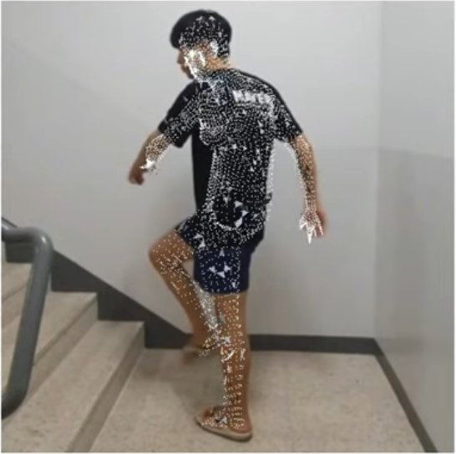
Introduction
3D Human Mesh Reconstruction
Model-based Method
Model-free Method

Slide 10
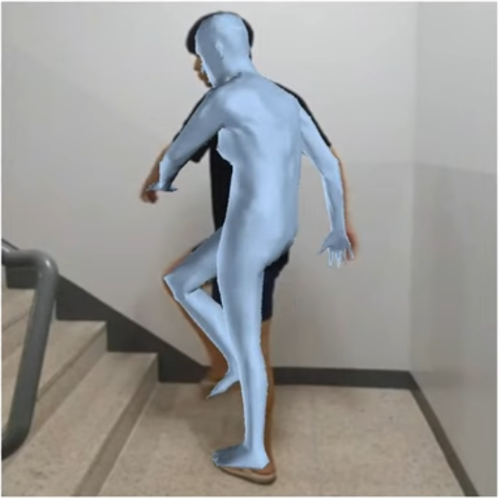
Introduction
3D Human Mesh Reconstruction
Model-based Method
Model-free Method

Slide 11
Introduction
3D Human Mesh Reconstruction
Complexity
Lack of stability
Learning difficulty
Model-based Method
Model-free Method

Slide 12
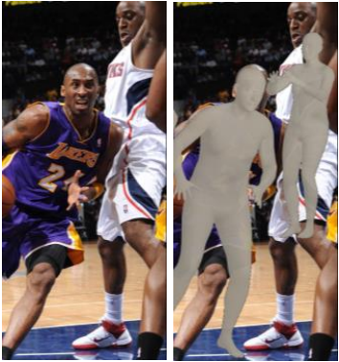
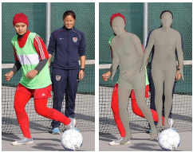
Introduction
Monocular, One-stage, Regression of Multiple 3D People
Yu Sun et al. 2021

Slide 13
Method
Represent possession relationship between all human instances and their visible body joints in feature space
Center-aligned instance map
Joint-aligned instance map
Input image

Slide 14
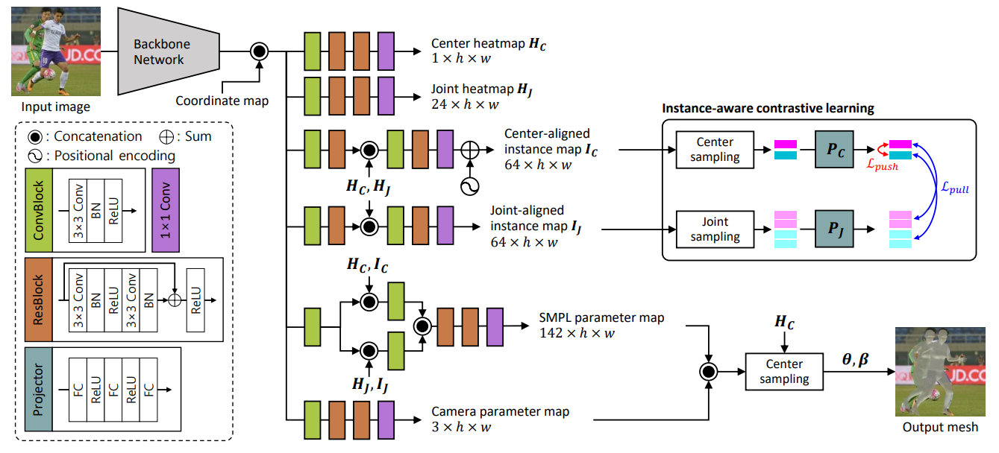
Method

Slide 15
Method
Instance-aware contrastive learning
Feature Encoding
Sampling
Push-Pull mechanism

Slide 16
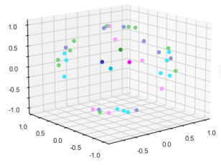
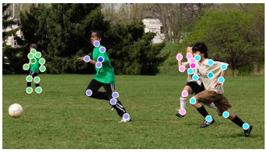
Method
Instance-aware contrastive learning
Input image
Latent space
(early in training)

Slide 17
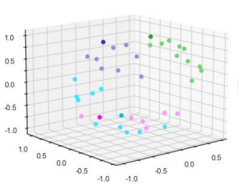
Method
Instance-aware contrastive learning
Input image
Latent space
(middle of training)

Slide 18
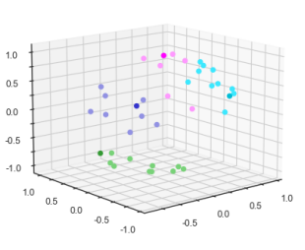
Method
Instance-aware contrastive learning
Input image
Latent space
(after training ends)

Slide 19
Method

Slide 20
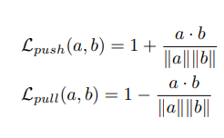
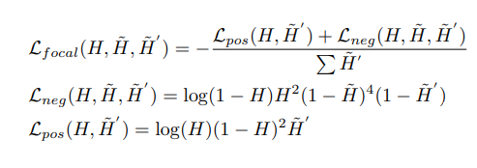
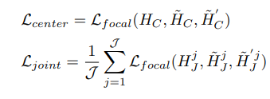
Method

Slide 21
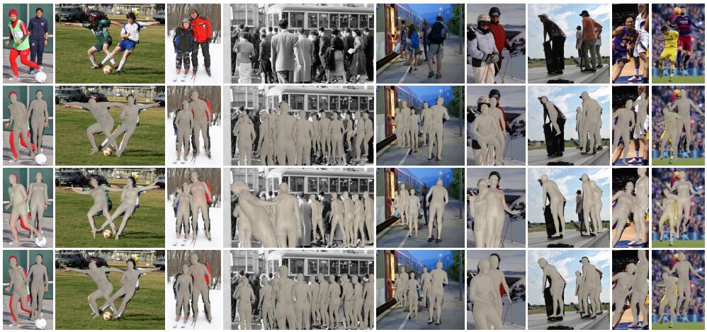
Result
Input image
ROMP
3D CrowdNet
Proposed Method

Slide 22
Result
MPJPE(Mean Per-Joint Position Error)
PA-MPJPE(Procrustes Aligned Mean Per-Joint Position Error)
MPVPE(Mean Per-Vertex Position Error)
AP(Average Precision)

Slide 23
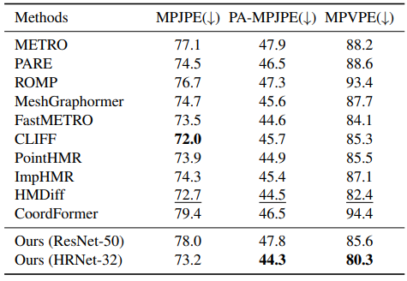
Result
Performance comparison based on the 3DPW

Slide 24
Conclusion
To address the challenge of person-to-person occlusions, we propose a simple yet powerful method for human mesh reconstruction.
Embedding identity information into the latent features of each person's body centers and joints
Proposed a novel instance-aware contrastive learning approach.
It performs reliably even in various person-to-person occlusion scenarios that occur in real-world environments.

Slide 25
Q & A

